Slide 1
PATIENT TRANSFERRING : SAFE MANUAL AND MECHANICAL TRANSFER
GENERAL NURSING : ENHANCING SKILLS & PRACTICES 2023
^{28TH} JULY 2023
PRESENTED BY: NURUL WAFIQAH BINTI AZMAN
PREPARED BY : NUR HAZIRAH ALIFAH BINTI ABDUL HALIM
PEGAWAI PEMULIHAN PERUBATAN, HSAAS

Slide 2
OUTCOMES
DEFINITION
OBJECTIVE
ASSISTANCE TERMINOLOGY
COMPONENTS
PRECAUTION
TYPE OF TRANSFER
EQUIPMENT / ASSISTIVE DEVICE

Slide 3
DEFINITION
WHAT IS PATIENT TRANSFER?
safe movement of a person from one place or surface to another
(Dutton, 2014)
most common patient transfers are from a bed to a stretcher and from a bed to a wheelchair
(Bergman, 2022)

Slide 4
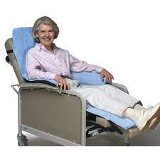
OBJECTIVE
permit a patient to function in different environments
to increase the level of independence of the patient
(Dutton, 2014)
to prevent pressure ulcers
improve cardiopulmonary status
(Bergman, 2022)

Slide 5
ASSISTANCE TERMINOLOGY
DEPENDENT
CG 100%
MINIMUM ASSIST
pt 75%, CG 25%
MODERATE ASSIST
pt 50%, CG 50%
MAXIMUM ASSIST
pt 25%, CG 75%
INDEPENDENT
CLOSE SUPERVISION / CONTACT GUARD
Caregiver has hands on pt ‘just in case’
SUPERVISION
Caregiver is nearby
(Venema et al, 2013)

Slide 6
COMPONENTS
PREPARATION
BODY MECHANICS
INSTRUCTION / COMMUNICATION
PATIENT POSITION AND SAFETY

Slide 7
PREPARATION
Perform proper hand hygiene
Remove jewelry on hands/wrists
Check the patient’s chart/room for any additional precautions (cognitive, weak side, weight bearing status)
Assess ABCDs (airway, breathing, circulation, and disability)
Ensure that all tubes, attachments, monitors, attached machines, patient wristbands, and lines are placed properly
Plan type of transfer
Place wheelchair close to bed or chair (30-45 deg)
Remove armrest and footrest that closest to the bed/chair.
Obtain necessary equipment (transfer board / transfer belt)
Wheelchair and hospital bed wheels are locked
Block feet or knees weak side. Never wear sock but wear shoes to add more friction.
(Bergman, 2022)

Slide 8
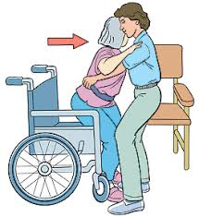
BODY MECHANICS
Adjust the height of the bed as needed
Use a wide base of support
Maintain the natural curves of your back ‐ Bend at your hips and knees instead
stay close to patients at all times during the transfer to keep the patient’s weight close to you
not to let patients wrap their arms around the caregiver’s head.
Move or pivot your feet to turn; do not twist at your back
Always let your patient assist as much as possible
Perform transfer in a smooth motion
If more than 1 person is assisting, communicate
(Venema et al, 2013)
(Bergman, 2022)

Slide 9
INSTRUCTION / COMMUNICATION
Clear and short instructions should be verbalized clearly to patient , caretaker and assistant
If more then one person involved, communication is essential.
“on the count of three, 1..2..3.. Lift!”

Slide 10
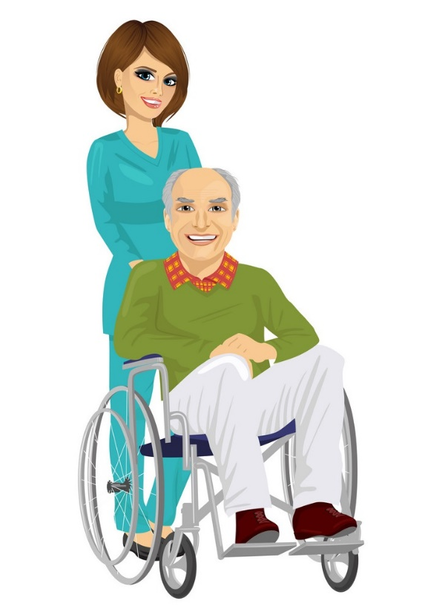
PATIENT POSITION & SAFETY
The transfer is NOT complete until the patient is safely and secure in the new position
Ensure:
patient is not sliding
attach arm rest and foot rest, wheelchair belt if required
ensure all wires / tubes in place
support limb (for stroke or fracture cases)
patient is comfortable

Slide 11
PRECAUTION
THR
avoid hip flexion > 90 ,hip abd & hip rotation.
Low back trauma or LBP & SCI
log roll onto their side. Allow feet to come off bed. Rise pt to sitt. Avoid lumbar rotation, lateral flexion and flexion.
Burns
avoid shear forces across burn or graft site and sliding.
Hemiplegia
DO NOT pull on affected UL or LL. Pulling can cause dislocate or overstretch the joint capsule.
Always support affected limb after transfer

Slide 12
TYPE OF TRANSFER
PIVOT TRANSFER
2-MAN TRANSFER
MECHANICAL TRANSFER - HOIST

Slide 13
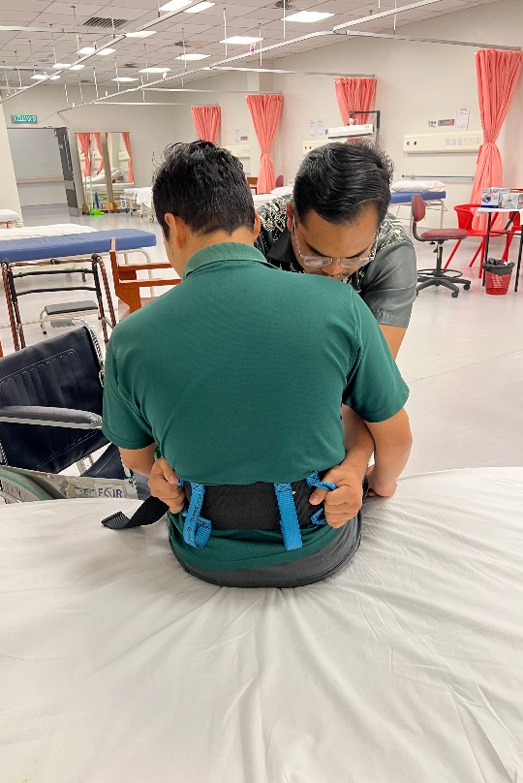
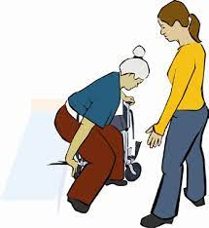
PIVOT TRANSFER
Pivot : the central point, pin or shaft on which a mechanism turns or oscillates.
Squat Pivot
Pt with good sitting balance and upper limb strength
for pt with limited trunk control, knee or hip strength.
Stronger side UL and LL next to w/c
Stand Pivot
Can stand for a short time
Have adequate LL muscle strength
Good sitting balance.
Use transfer belt.
Stronger side UL and LL next to w/c

Slide 14
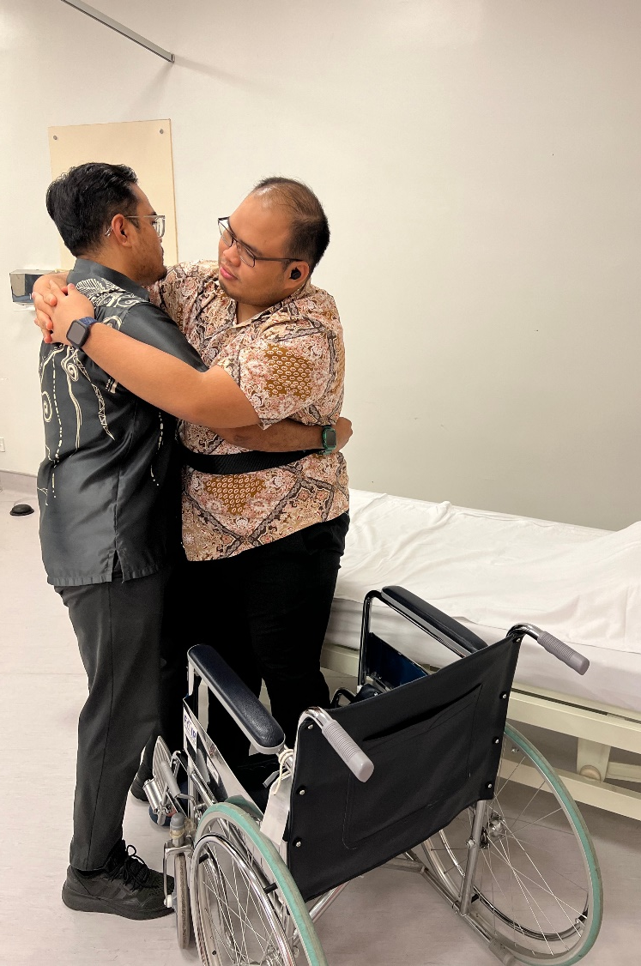
STAND PIVOT TRANSFER
Put transfer belt on the pt
w/c next to the bed (30-45deg) with the brakes locked.
Scoot pt forward to the edge of bed
Feet should be flat on the floor just behind the knee.
Cue the pt.
Pt should come to a standing position.
Pivot the feet, move the buttocks toward w/c.
Must pivot with the body to eliminate twisting at knee and ankle.
Slowly lowers to sit.
(Venema et al, 2013)

Slide 15
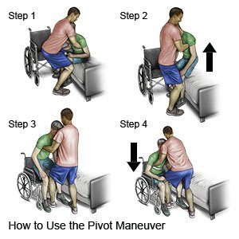
Squat Pivot Transfer
https://www.youtube.com/watch?v=qy4oq8SoEx4
Stand Pivot Transfer
https://www.youtube.com/watch?v=LZAYejxPl5Q

Slide 16
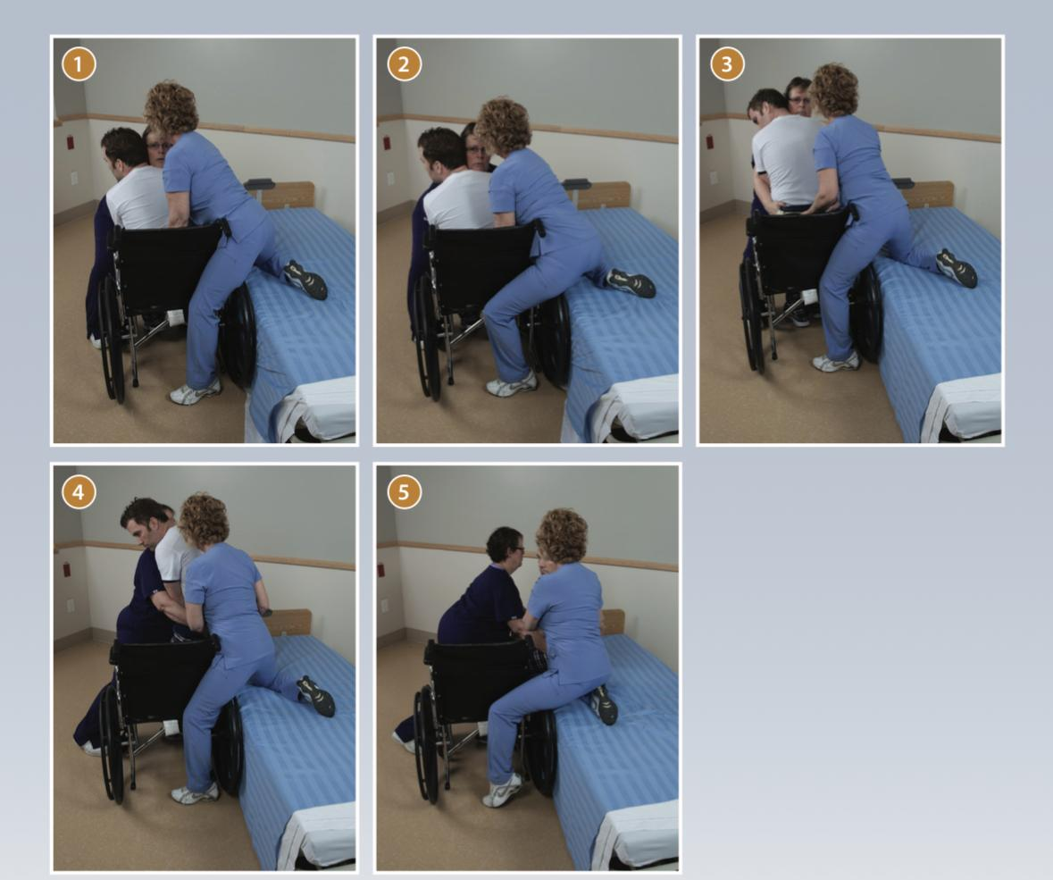
PIVOT TRANSFER (2 PERSON)

Slide 17
2-MAN TRANSFER
Taller lifter should stand at the back, shorter lifter stand on one side or in front.
Lifter at the back should put his or her arms under the pt’s sh and around the pt’s chest with arms folded across the pt’s chest.
Widen the BOS and slightly flex hips and knee.
Shorter lifter, places both arm under the pt’s thighs. Clasp one hand to wrist for firm grip.
Widen the BOS by spreading feet apart.
Lifter at the back must counts to 3 which both lifters should straighten hips and knees to lift the pt’s in unison.
Step to the transfer surface and place the pt.
Reposition the pt for comfort.
(Venema et al, 2013)

Slide 18
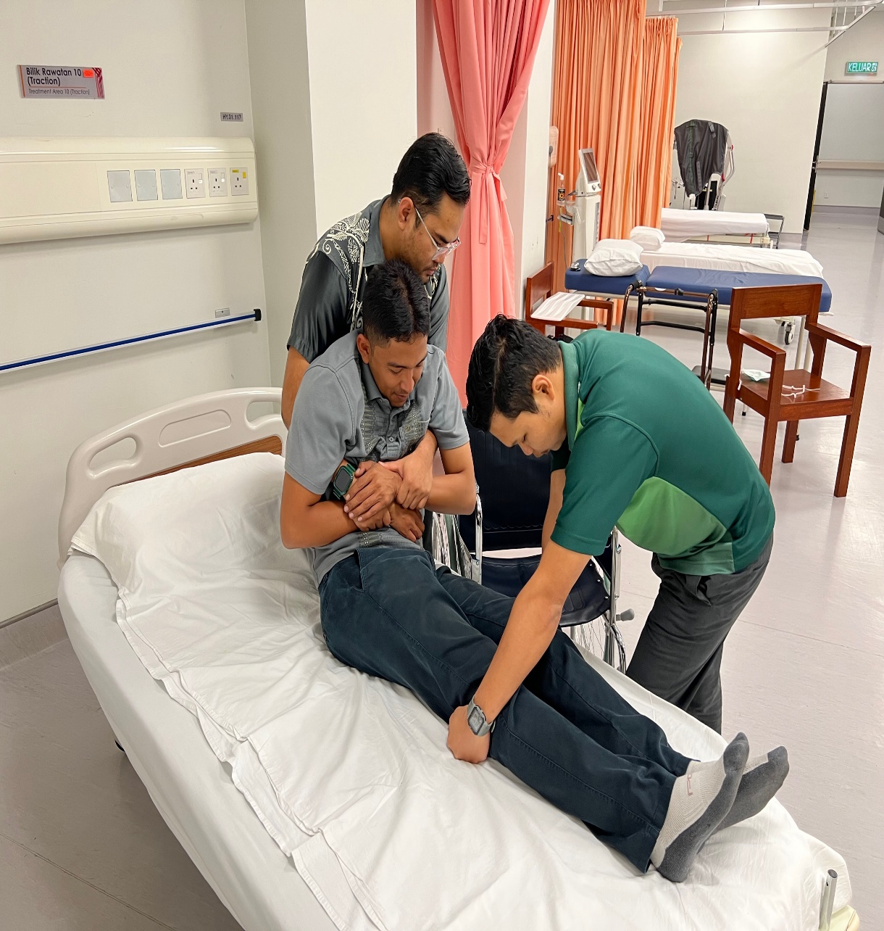
2-Man Transfer
https://www.youtube.com/watch?v=3PDTn57MQ2A

Slide 19
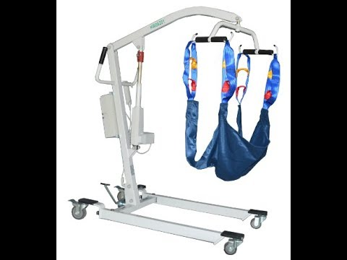
MECHANICAL TRANSFER - HOIST
Pt is dependent or need max assistance.
Pt with poor trunk and neck control
Pt unable to obey command
weight bearing restrictions bilateral LL
restricted to perform active transfer.
Pt too big or obese.

Slide 20
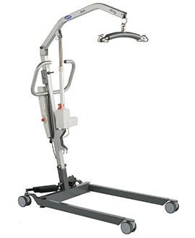
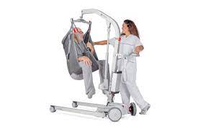
MECHANICAL TRANSFER - HOIST
https://www.youtube.com/watch?v=EZ6FptTLc08

Slide 21
EQUIPMENT / ASSISTIVE DEVICE
TRANSFER BELT
TRANSFER BOARD
MECHANICAL HOIST

Slide 22
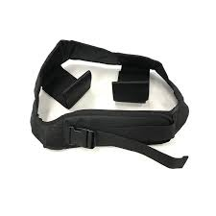
TRANSFER BELT

Slide 23
TRANSFER BOARD
A transfer board is typically a flat, rigid board made of wood or plastic.
bridge two surfaces and allows you to move between surfaces without using your legs.
It allows for several small movements instead of one big motion.
less upper body strength than other types of transfers.
HOW TO :
places the sliding transfer board under the patient's buttock/leg. Placing the sliding transfer board under the patient's buttock/leg will prevent the patient from falling off the board. Fingers should not be under the board to avoid pinching the fingers.
The slide board should extend the distance between the bed and the wheelchair.
The assistant places one knee between the patient’s knees and the other knee near the wheelchair's front, close to the other surface.
The assistant holds the transfer belt and slowly slides the patient across the board
(Bergman, 2022)

Slide 24
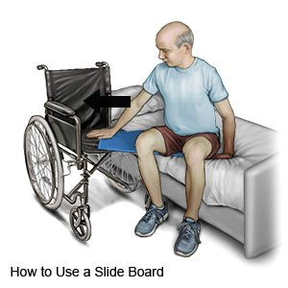
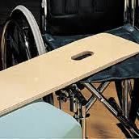
TRANSFER BOARD
https://www.youtube.com/watch?v=SwAtLenYxck

Slide 25
HOIST

Slide 26
CONCLUSION
Pt and therapist safety is most importance during transfers.
Doubt about the level of assistance, ask for additional assistance.
Special precaution with transfer in some cases
Use proper body mechanics – REDUCE THE RISK OF HAVING LBP
There is always a risk for falls, and no transfer technique is without risk.
If the patient starts to fall during the transfer, lower them down to the nearest flat surface, bed, chair or floor.

Slide 27
REFERENCE
1. Patient transfers and mobility. Dutton M(Ed.), (2014). Introduction to Physical Therapy and Patient Skills. McGraw Hill. https://accessphysiotherapy.mhmedical.com/content.aspx?bookid=1472&sectionid=86198760
2. Bergman R, De Jesus O. Patient Care Transfer Techniques. [Updated 2022 Oct 17]. In: StatPearls [Internet]. Treasure Island (FL): StatPearls Publishing; 2022 Jan-. Available from: https://www.ncbi.nlm.nih.gov/books/NBK564305/
3. Venema DM, Hassel J & Jones KJ, (2013) . Best Practices in Safe Transfers and Mobility to Decrease Fall Risk University of Nebraska Medical Centre. Retrieved from https://www.unmc.edu/patient-safety/_documents/safe-transfers-mobility-handout.pdf

Slide 28
THANK YOU!

