Slide 1
Nursing management in stroke rehabilitation :
BEDSIDE SWALLOWING SCREENING
IN STROKE PATIENT
NIK NOR HARAMAINI BINTI NIK ABDUL GHANI
PEGAWAI PEMULIHAN PERUBATAN PERTUTURAN
UNIT TERAPI PERTUTURAN-BAHASA, JABATAN PERUBATAN REHABILITASI

Slide 2
Topics
Dysphagia
Swallowing phases
Screening & Oral care
Dysphagia Diet

Slide 3
What is dysphagia ?
Characterized by a dysfunction in the sequential oral, pharyngeal and esophageal phases of swallowing problems.
Dysphagia is not a disease itself, rather a symptom and effect of another pathologic condition

Slide 4
Stroke & dysphagia
Research has proven that more than 80% stroke patients has dysphagia
42-67% occur within 3 days
11-13% remain dysphagic after 6 months.
A study reported that 80% of patients with prolonged dysphagia required alternative means of enteral feeding.

Slide 5
Signs and symptoms of dysphagia
NG tube and PEG tube insitu
Recurrent chest infection
Unexplained weight loss
Dehydration
Refusal to eat / loss of appetite
Prolong eating time
Food sticking in the mouth after swallow
Delay swallow initiation
Nasal regurgitation
Choking / coughing during eating
Difficulty of breathing after eating

Slide 6
Truths About Dysphagia
1
If a patient doesn’t cough, they aren’t aspirating
Silent aspiration occurs in as many as 25-52% of individuals in the acute care setting( Leder et al, 2011)
* It is critical to address dysphagia in the acute care setting (Tippet, 2011)

Slide 7
Truths About Dysphagia
2
Aspiration always leads to pneumonia
Only 12% of individuals who aspirate develop aspiration pneumonia (Robbins et all, 2008)

Slide 8
Truths About Dysphagia
3
If a person has a diminished gag reflex/absent gag reflex, they likely have dysphagia
An absent gag is a completely normal thing for 37% percent of the population. The absence of a gag reflex does not appear to be a predictor of dysphagia. Based on Leder, S. B. (1996). Gag reflex and dysphagia. Head & Neck: Journal for the Sciences and Specialties of the Head and Neck, 18(2), 138-141.

Slide 9
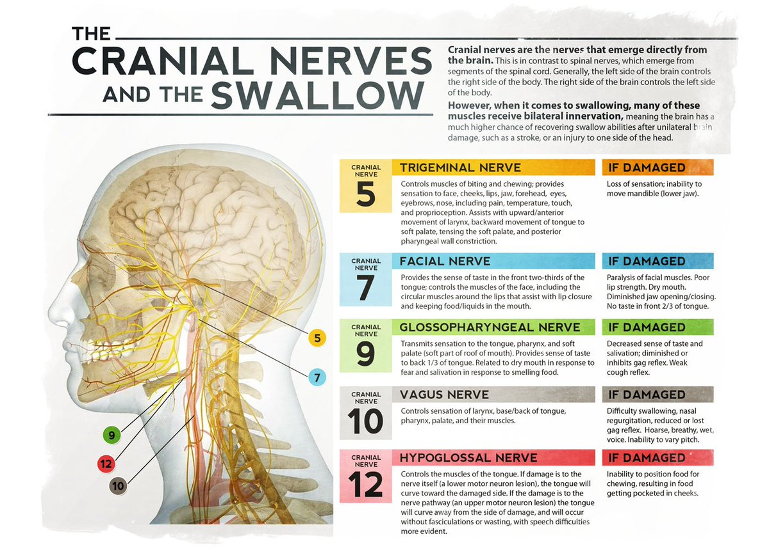
Facts
Humans swallow :
500-700 times a day
once per minute while awake
around 3x per hour during sleep
even more often during meals

Slide 10
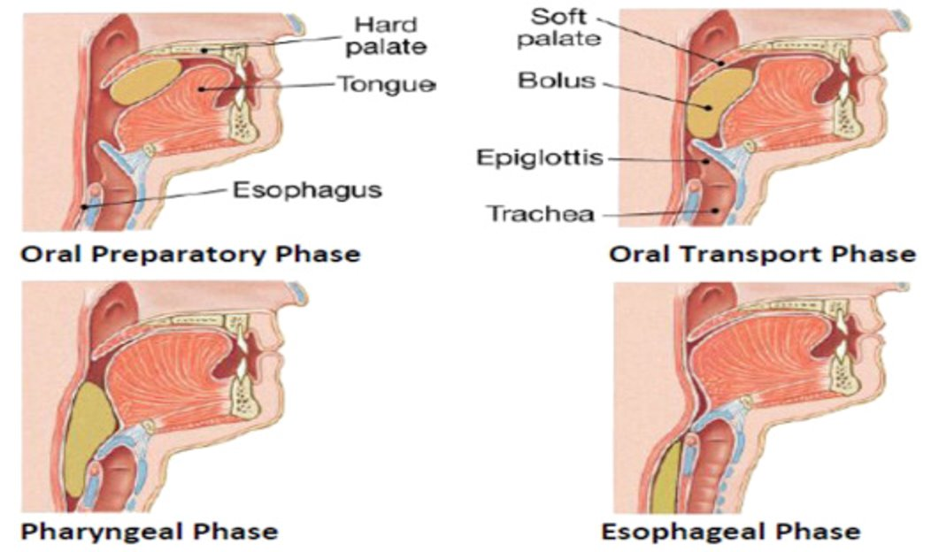
Phases of swallowing
Oral phase
Pharyngeal phase
Esophageal phase
https://www.google.com/search?q=swallowing&tbm=vid&sa=X&ved=2ahUKEwjas8rqjIuAAxVfR2wGHa8CBy0Q0pQJegQIChAB&cshid=1689231266683705&biw=1920&bih=961&dpr=1#fpstate=ive&vld=cid:38a9bc32,vid:YQm5RCz9Pxc

Slide 11
Phases of swallowing
Oral phase | oral preparatory phase : -manipulated, masticated and mixed with saliva in preparation for swallowing -back of tongue controls the position, preventing premature spillage
 | tongue transfer bolus of food to the pharynx
Pharyngeal phase | complex and coordinated movement of the tongue and pharyngeal structures propel the bolus into esophagus, while protecting airway (*VF close)
Esophageal phase | coordinated contraction of muscle of esophagus move bolus through esophagus towards stomach

Slide 12
m
Dysphagia management
occupational therapist
otorhinolaryngologist
neurologist
otorhinolaryngologist
social worker /psychologist
dietitian
nurses
radiologist/radiographer
general medicine/rehab medicine
dentist

Slide 13
Dysphagia management
Dysphagia screening
Instrumental assessment (yes/no)
Swallowing rehabilitation (intervention)
Clinical Swallowing Examination

Slide 14
Notes:
What is the role of the nurse in caring for a patient with dysphagia?
The main objective when caring for the dysphagic patient is promoting safe swallowing and ensuring the patient has food and fluids that are the appropriate texture and thickness for their diet

Slide 15
WHY we need collaboration ?
Nursing observations and opinions are crucial in fully understanding all dimensions of a case for a patient with dysphagia
WHY ??
Nurses play an important role in helping to implement the recommendations of the SLP.
Following a dysphagia evaluation, the SLP will communicate to the nurse, as well as the necessary recommendations.
Example:
Mr. A had a FEES completed today.
Result - he was able to tolerate thin liquids with use of chin-tuck procedure. SLP would communicate to the nurse, Mr. A must use the chin-tuck position whenever consuming thin liquids.
Notes:
Inter-professional collaboration between nurses and SLT… Nurses are often the eyes and ears for the SLP who may only see a patient for a short treatment session

Slide 16
Dysphagia Screening
Quick and minimally invasive
Identifies an individual who may or may not need a complete dysphagia assessment
Defined scoring system:
Pass – patient can be fed
Fail – patient kept NPO and speech language therapist is consulted for a comprehensive swallowing assessment.
Notes:
Screening procedures are usually used to determine the possible presence of dysphagia and the need for further investigation.

Slide 17
Dysphagia Screening Tools
Notes:
Screening procedures are usually used to determine the possible presence of dysphagia and the need for further investigation.

Slide 18
Dysphagia Screening Tools
Notes:
Screening procedures are usually used to determine the possible presence of dysphagia and the need for further investigation.

Slide 19
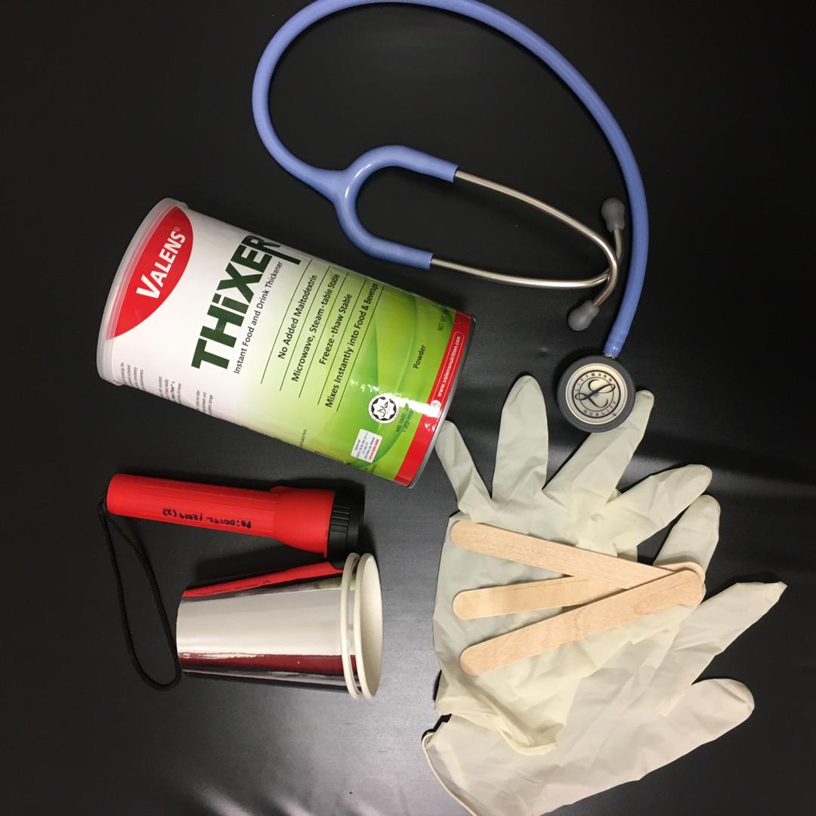
Swallowing Screening Form (SSF)
WHAT?
The Standardized Swallowing Assessment is a stable and accurate dysphagia tool used during acute stroke to screen dysphagia.
TIME
10 minutes to administer
WHO
General physician/ nurses
ACCURACY LEVEL
94-95%
adapted from Standardized Swallowing Assessment (Ellul et. al. 1993, 1996, 1997 ; Perry, 2001)
Notes:
Screening procedures are usually used to determine the possible presence of dysphagia and the need for further investigation.

Slide 20
Screening Checklist and
Screening Form (SSF)
Notes:
Screening procedures are usually used to determine the possible presence of dysphagia and the need for further investigation.

Slide 21
Notes:
Screening procedures are usually used to determine the possible presence of dysphagia and the need for further investigation.

Slide 22
Notes:
Screening procedures are usually used to determine the possible presence of dysphagia and the need for further investigation.

Slide 23
Contraindication for
dysphagia screening
Reduced alertness
Poor respiratory status
Absent protective cough
Poor ability to manage secretions/ spontaneous swallow
Poor oral hygiene
Significant oral candida
Notes:
Screening procedures are usually used to determine the possible presence of dysphagia and the need for further investigation.

Slide 24
Oral care for patients with dysphagia
Notes:
Screening procedures are usually used to determine the possible presence of dysphagia and the need for further investigation.

Slide 25
Oral care
WHY is it important ?
-maintain comfort
-easier chewing/swallowing
-decreases sensation of dry mouth, dehydration
-improves communication
-enhance QOL
What does it involve?
keep mouth and lips clean, moist
-remove debris, dried secretion
clean the tongue
Notes:
Screening procedures are usually used to determine the possible presence of dysphagia and the need for further investigation.

Slide 26
Notes:
Screening procedures are usually used to determine the possible presence of dysphagia and the need for further investigation.

Slide 27
Current practice
at HSAAS UPM
-dip toothette/gauze in mouthwash/thymol , squeezes excess off, and clean oral cavity ( tongue etc)
-lip balm
- xxxxxx
Notes:
Screening procedures are usually used to determine the possible presence of dysphagia and the need for further investigation.

Slide 28
DYSPHAGIA DIET
AT HSAAS
-
Notes:
Screening procedures are usually used to determine the possible presence of dysphagia and the need for further investigation.

Slide 29
adapted from International Dysphagia Diet Standardization Initiative (IDDSI)
-
Notes:
Screening procedures are usually used to determine the possible presence of dysphagia and the need for further investigation.

Slide 30
-
Notes:
Screening procedures are usually used to determine the possible presence of dysphagia and the need for further investigation.

Slide 31
-
Notes:
Screening procedures are usually used to determine the possible presence of dysphagia and the need for further investigation.

Slide 32
-
Notes:
Screening procedures are usually used to determine the possible presence of dysphagia and the need for further investigation.

Slide 33
-
Notes:
Screening procedures are usually used to determine the possible presence of dysphagia and the need for further investigation.

Slide 34
-
Notes:
Screening procedures are usually used to determine the possible presence of dysphagia and the need for further investigation.

Slide 35
-
Notes:
Screening procedures are usually used to determine the possible presence of dysphagia and the need for further investigation.

Slide 36
-
Notes:
Screening procedures are usually used to determine the possible presence of dysphagia and the need for further investigation.

Slide 37
-
Notes:
Screening procedures are usually used to determine the possible presence of dysphagia and the need for further investigation.

Slide 38
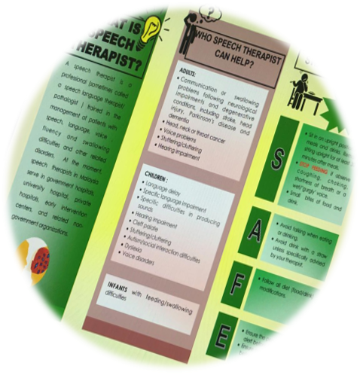
SAFE Swallowing Strategies
S
SIT UPRIGHT POSITION
STOP FEEDING
SMALL BITES
A
AVOID TALKING
AVOID STRAW
F
FOLLOW DIET MODIFICATION
E
ENSURE ALERT
ENSURE ORAL HYGIENE
Notes:
Strategi yang diberikan adalah berbeza-beza antara pesakit mengikut masalah menelan yang dihadapi.
Matlamat utama dalam rawatan masalah menelan adalah untuk mengurangkan risiko semasa menelan dan risiko kematian yang dikaitkan dengan jangkitan paru-paru. Selain itu, rawatan yang diberikan supaya pesakit kembali mengambil diet secara normal. Ini seterusnya dapat meningkatkan kualiti hidup mereka (Singh & Hamdy 2006).

Slide 39
Take home message
SLPs and other health professional (rehab physicians, nurses, dietitians etc) can work together to deliver collaborative care to patients with dysphagia and improve not only swallow function, but also, overall quality of life.
Management should be aimed at facilitating safe swallowing while spontaneous recovery takes place.
Texture modified foods are provided clinically to reduce choking risk and manage dysphagia. Careful choice of food textures and ingredients is required to maximize oral intake, especially protein intake, to maintain adequate nutrition.
It is important to establish collaborations early in interdisciplinary healthcare training in order to improve quality of patient care.

Slide 40
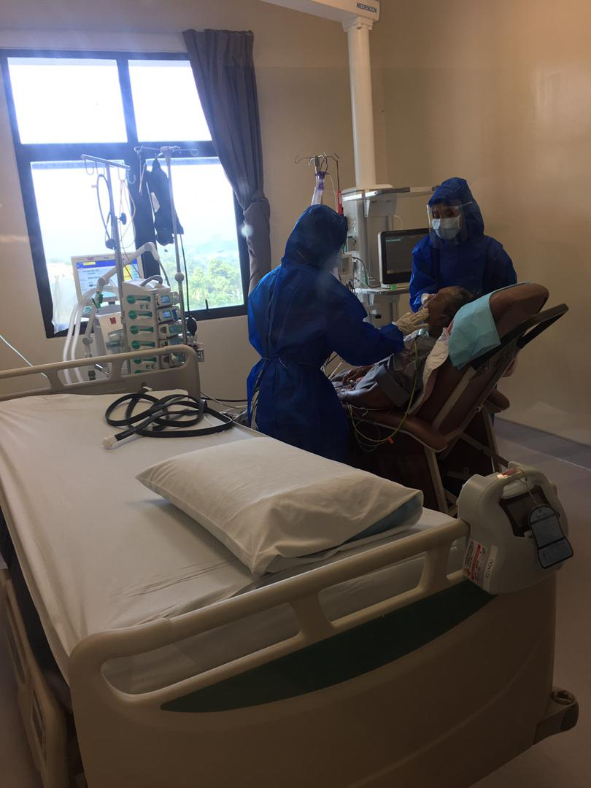
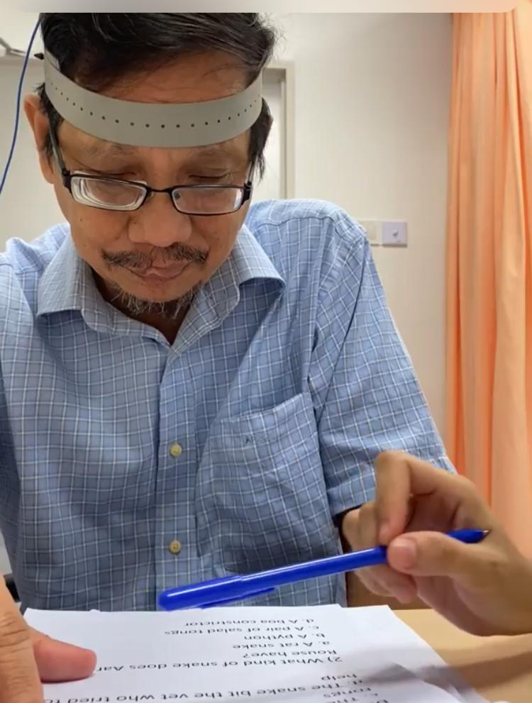
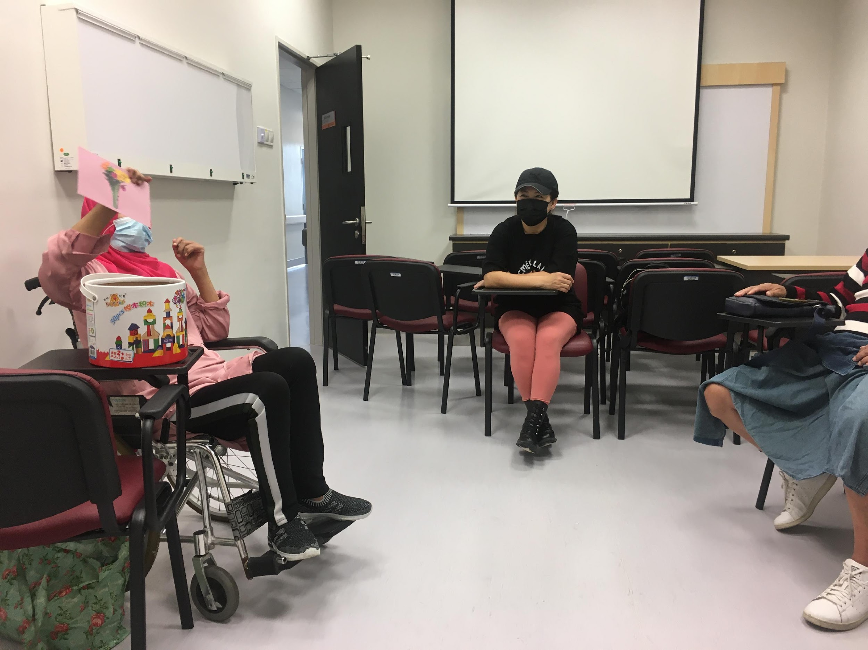
SERVIS KLINIK TERAPI PERTUTURAN-BAHASA
In patient service (adult)
Out patient service (adult)

Slide 41
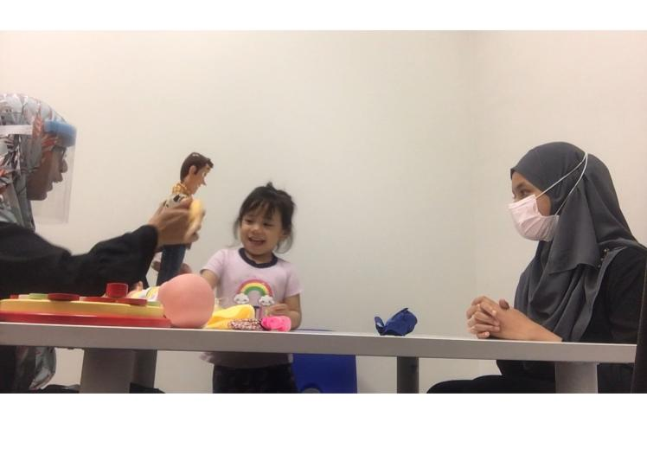
SERVIS TERAPI PERTUTURAN
In patient service (paed -feeding) & Out patient service (paed)

Slide 42
Terima Kasih

